Slide 1

Energy Consumption Forecasting Pipline
GROUP MEMBERS:
1. Ravindra Mukkapati 2. Venkatesh Marupaka
3. Archana Manjunath Reddy 4. Eswari Akshaya Angarapu

Slide 2
TABLE OF CONTEXT
ABSTRACT
PROBLEM STATEMENT
AWS SETUP
TOOL AND TECHNOLOGIES
LOW & HIGH LEVEL ARCHITECTURE
ORCHESTRATION & SCHEDULING
TESTING
ERROR HANDLING
GIT INTEGRATION
VISUALIZATIONS
OUTCOMES

Slide 3
Abstract
This project, Energy Consumption Forecasting Pipeline, helps in predicting household energy usage for better planning and cost savings. We built a data pipeline using AWS S3, Databricks, PySpark, and Delta Lake.
The pipeline follows the Bronze–Silver–Gold architecture:
Bronze: Stores raw data from CSV files in S3.
Silver: Cleans and standardizes the data.
Gold: Creates useful features for forecasting.
It runs daily at 4 AM, checks for errors, and sends alerts for data issues. The system is scalable, reliable, and prepares data for accurate energy consumption forecasting. In the future, we can extend it with real-time streaming, advanced ML models, and dashboard integration.

Slide 4
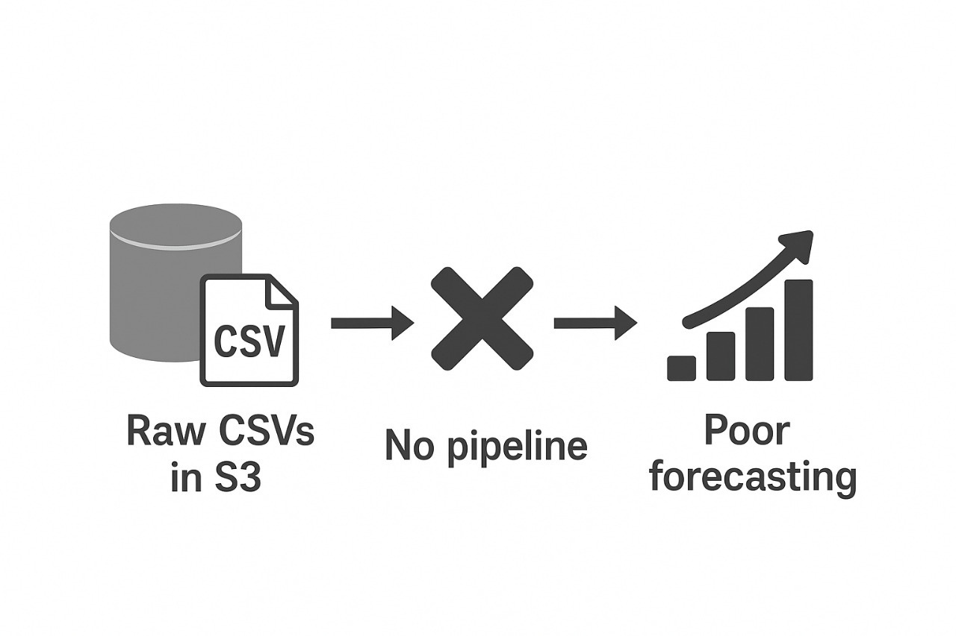
Problem Statement
With the rapid rise in electricity demand, power companies face challenges in managing resources and predicting consumption accurately. Manual tracking of household power usage is time-consuming, error-prone, and inefficient. Without proper forecasting, this leads to imbalanced energy distribution, higher operational costs, and potential outages.
To solve this, there is a need for an automated, scalable, and reliable data pipeline that can process energy usage data daily, ensure data quality, and provide accurate consumption forecasts to support better resource planning and cost optimization.

Slide 5
Primary Objective
The main objective of this project is to design and implement an automated, scalable data pipeline that ingests, cleans, transforms, and forecasts household energy consumption data for better resource planning.
Tech stack
Databricks → Orchestration, Spark processing
AWS S3 → Raw data storage
PySpark → Data processing & transformations
Delta Lake → Bronze/Silver/Gold architecture
boto3 → AWS integration
pytest → Unit testing & validation
Git (CodeCommit/GitHub) → Version control

Slide 6
DataSet Overview
This dataset contains household electricity consumption recorded at one-minute intervals from 2006 to 2010.
Important Columns:
Date, Time → Timestamp of measurement
Global_active_power → Total household power consumed (kilowatts)
Global_reactive_power → Power not consumed but circulated (kilowatts)
Voltage → Electrical voltage (volts)
Global_intensity → Current intensity (ampere)
Sub_metering_1, Sub_metering_2, Sub_metering_3 → Power consumed by specific household appliances/areas

Slide 7
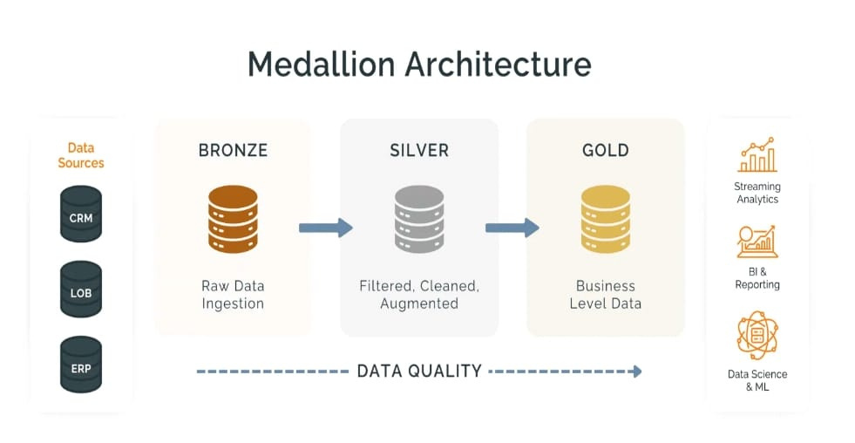
Bronze: Raw energy CSVs from AWS S3 stored as-is.
Silver: Cleaned & standardized data (duplicates removed, timestamps fixed).
Gold: Aggregated features (hourly/daily consumption) for forecasting.
Final Use: Reliable data used for ML forecasts & reports.

Slide 8
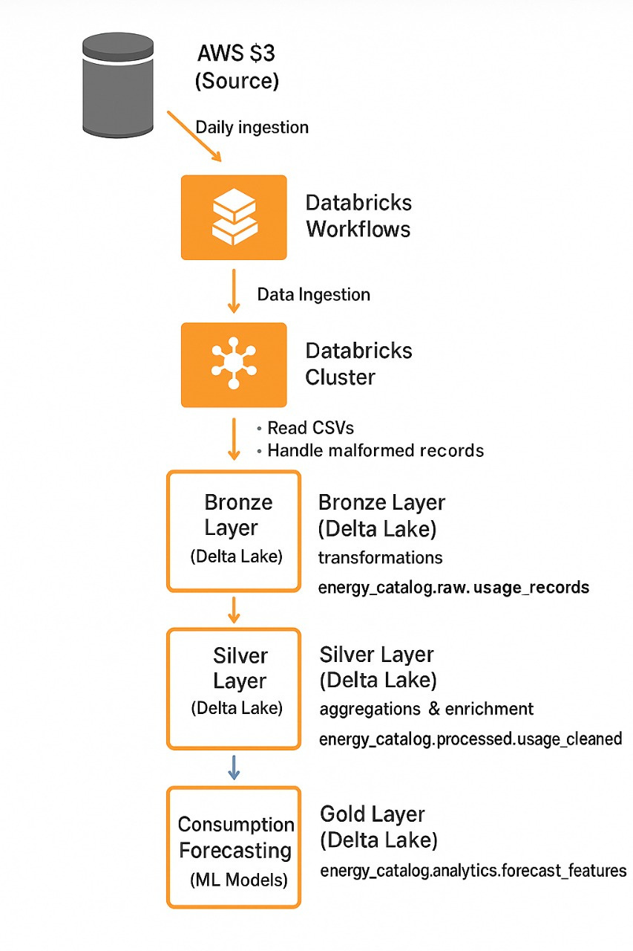
AWS Setup
Data Source (AWS S3): Raw CSV energy consumption data is ingested daily.
Databricks Workflows & Cluster: Automates ingestion, handles malformed records, and initiates ETL jobs.
Bronze Layer (Delta Lake): Stores raw data in Delta format for durability and reproducibility.
Silver Layer (Delta Lake): Cleansed and standardized datasets with deduplication, formatting, and enrichment.
Gold Layer (Delta Lake): Feature-engineered datasets for analytics, reporting, and ML consumption.
Consumption Forecasting (ML Models): Trained models generate demand forecasts and detect anomalies.

Slide 9
Tools & Technologies
🔹 Databricks
Cloud-based unified analytics platform.
Used for data engineering, ML model training, and workflow orchestration.
Provides Delta Lake support for ACID transactions and schema enforcement.
🔹 PySpark
Python API for Apache Spark.
Distributed computing framework for big data processing.
Handles ETL, data cleaning, transformation, and feature engineering.
🔹 Delta Lake
Open-source storage layer built on top of data lakes.
Ensures ACID transactions, time travel, and schema evolution.
Enables structured pipelines (Bronze → Silver → Gold layers).
🔹 AWS (Amazon Web Services)
S3: Stores raw energy consumption CSV files.
Glue: ETL service to create Bronze layer with crawlers.
IAM: Provides secure

Slide 10
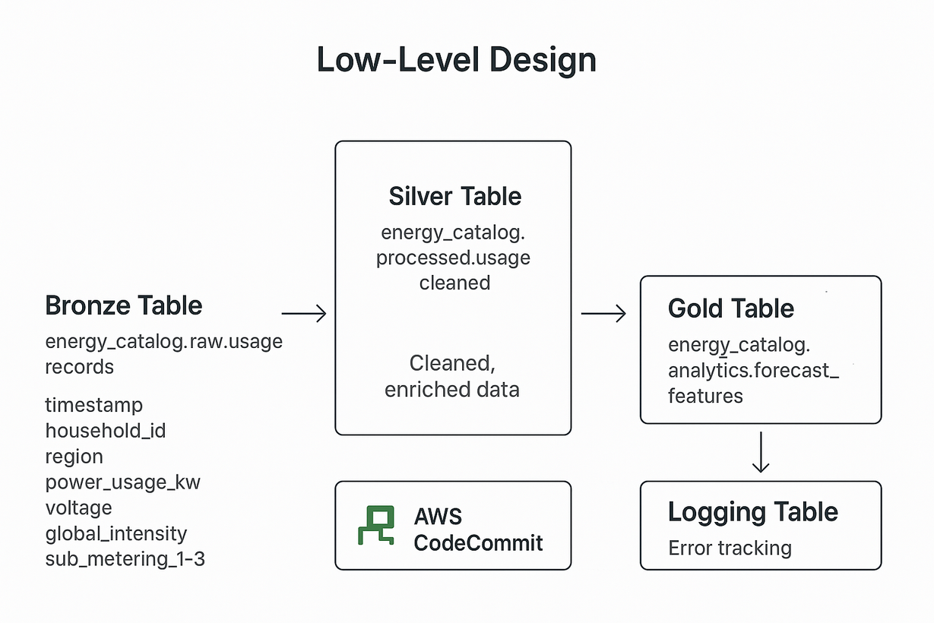
Low Level Architecture

Slide 11
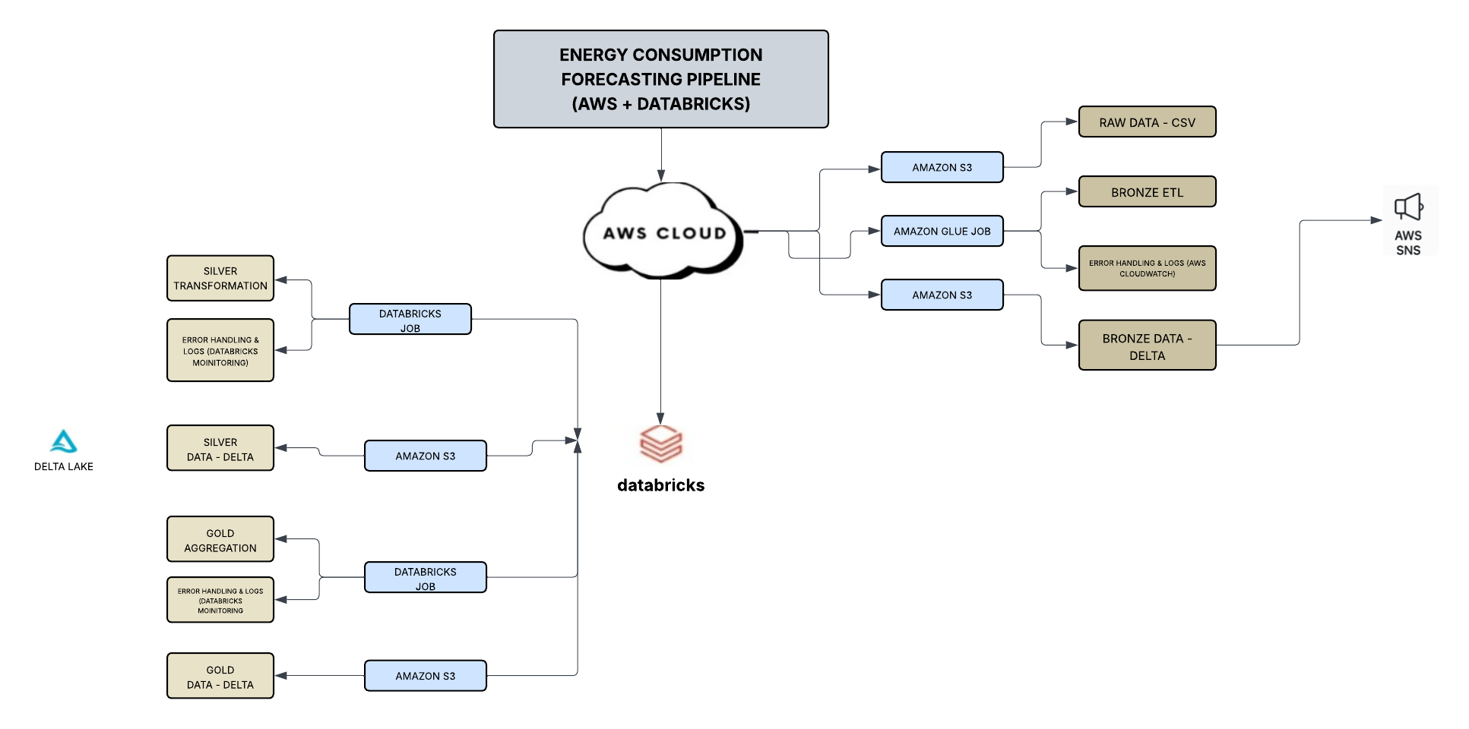
High Level Architecture

Slide 12
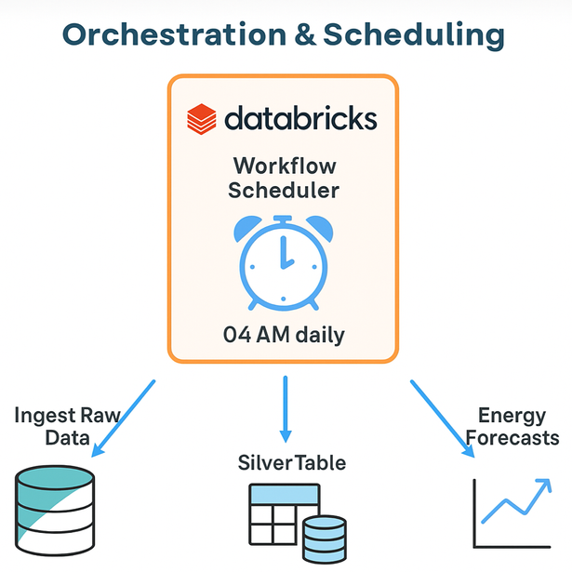
Orchestration & Scheduling
Our project focuses on building a scalable data engineering and analytics pipeline for the energy sector using AWS Glue, S3, and Databricks. The increasing global energy demand requires accurate forecasting and real-time insights, but raw datasets are often unstructured and lack an efficient processing pipeline. To address this, our solution implements the Medallion Architecture (Bronze–Silver–Gold layers), ensuring data is ingested, cleansed, enriched, and made analytics-ready. AWS Glue handles ETL automation and cataloging, while Databricks provides a collaborative environment for advanced transformations, machine learning, and forecasting. The final outcome is a robust, automated pipeline that delivers clean data, reliable forecasts, anomaly detection, and business-ready insights for smarter energy management.

Slide 13
Testing
Unit tests were implemented to validate the correctness of data transformation logic.
Integration tests were carried out using the Kaggle sample dataset to ensure smooth end-to-end flow.
Schema validation tests were performed to check that table structures and data types match the expected design.
Data integrity tests ensured the accuracy, completeness, and consistency of the records.
End-to-end validation was conducted before production deployment to confirm overall pipeline reliability.

Slide 14
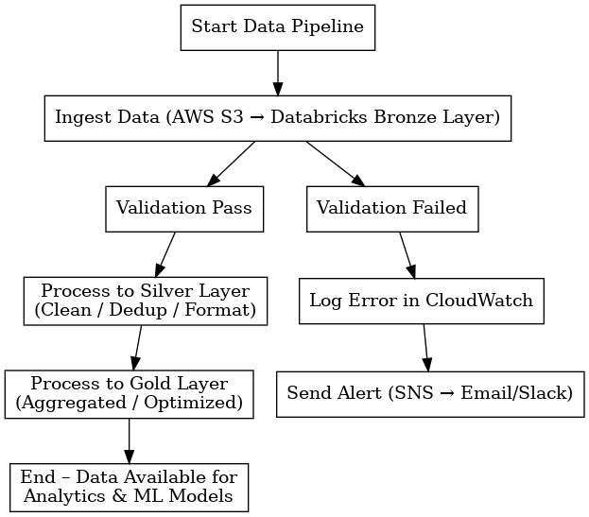
ERROR HANDLING
CloudWatch Logs – Tracks ingestion failures by capturing error messages, timestamps, and metadata for debugging.
Try/Except with Logging in Databricks – Wraps critical Spark operations to catch runtime errors and logs them for analysis.

Slide 15
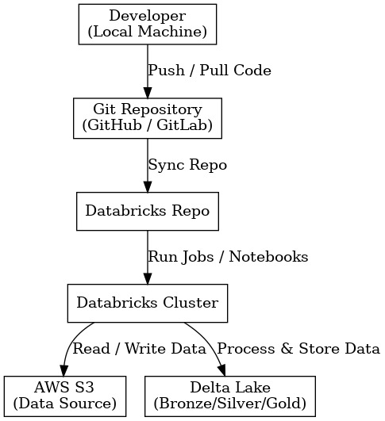
GIT Integration
Workflow:
Developer Workflow
Write notebooks locally or in Databricks.
Commit and push changes to Git repository.
Databricks Repo Sync
Connect Databricks to Git (via personal access token).
Pull latest code or push updates directly from Databricks.
Execution on AWS
Code executed on Databricks clusters.
Data sourced from AWS S3 and stored in Delta Lake (Bronze → Silver → Gold).
Deployment & CI/CD
Integrate with AWS CodePipeline or GitHub Actions for automated deployment.

Slide 16
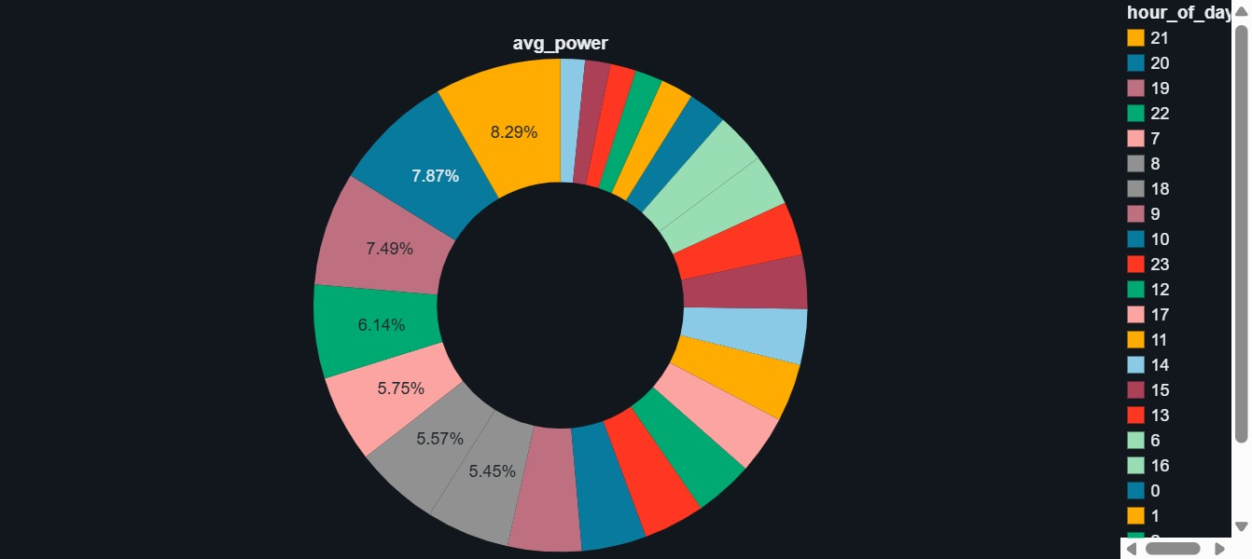
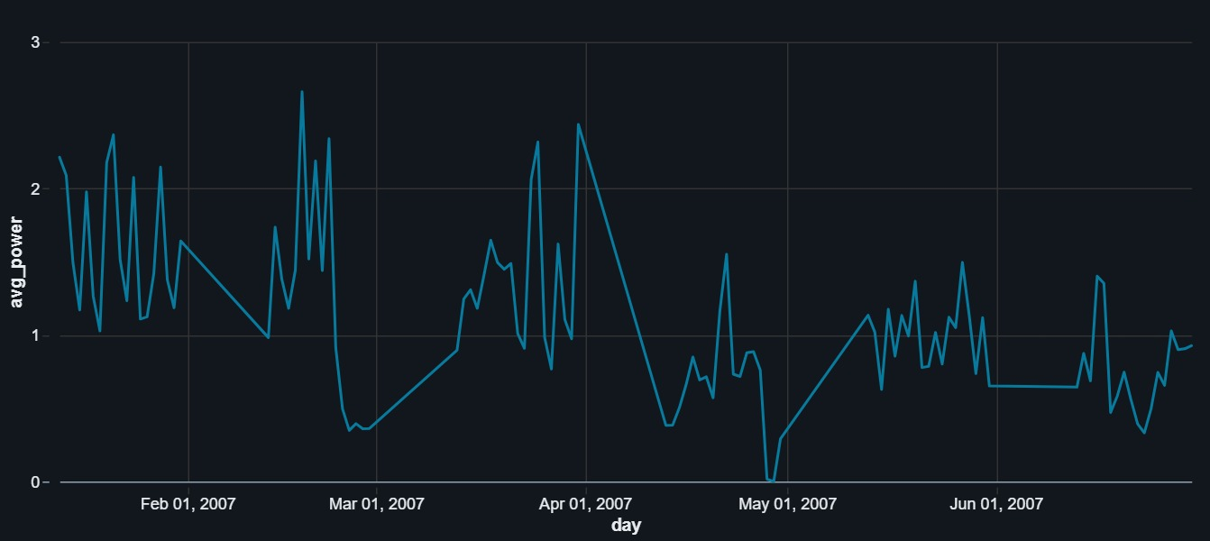
Visualizations
HOURLY CONSUMPTION PATTERN
Daily Average Power Consumption

Slide 17
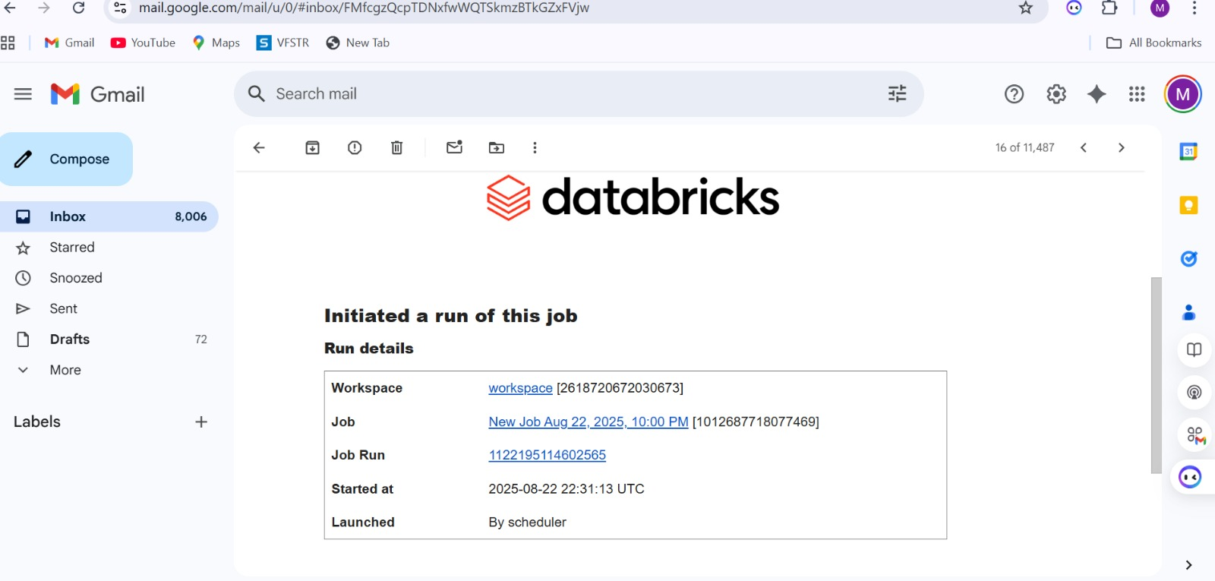
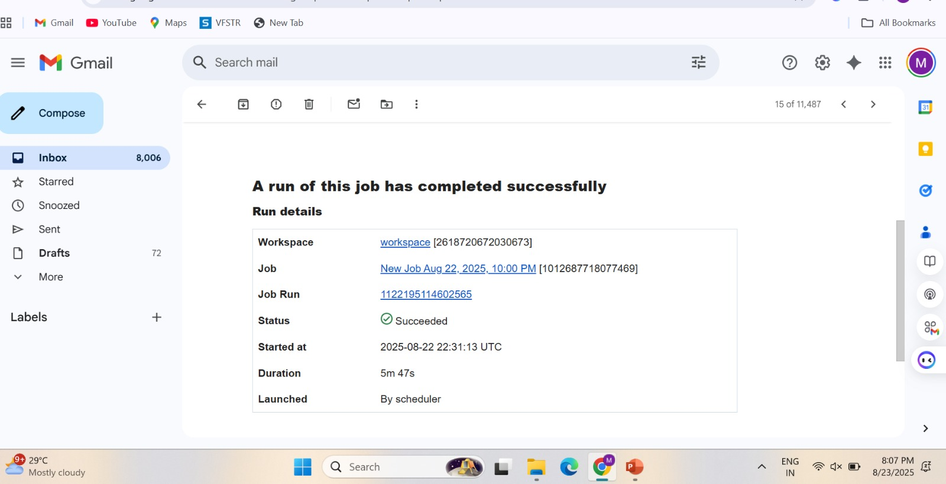
Alerts & Notifications

Slide 18
Outcomes
Built a scalable ETL pipeline for energy forecasting.
Optimized Bronze, Silver, Gold tables ready for analytics & ML.
Monitoring & alerts ensure less downtime, more trust.
Business users can see past trends & future predictions.
Improved energy planning & cost efficiency with accurate forecasts.

Slide 19
Thank you

